Slide 1

Database Management System
Lecture 17
Er. Shiva Kunwar
Lecturer, GU
02/20/2024

Slide 2

Lesson 7: Recovery System (3hrs)
Basic Concept of Crash Recovery
Classification of Failure
Recovery and Atomicity
Log-based Recovery and Shadow Paging
Notes:
Class discussion on real-world applications of databases.
Quiz on basic database terminology.
Hands-on exercise: Create a simple database using DDL commands.

Slide 3
Basic Concept of Crash Recovery
During the transaction processing, the transactions on the database can be interrupted.
If a failure occurs before all of the changes are made, the database is left in an inconsistent and unusable state.
Crash recovery is the process by which the database is moved back to a consistent and usable state.
After reaching the consistent state it has attained what is known as point of consistency.
Crash Recovery can be done by rolling back incomplete transactions and completing committed transactions that were still in memory when the crash occurred.
Notes:
Class discussion on real-world applications of databases.
Quiz on basic database terminology.
Hands-on exercise: Create a simple database using DDL commands.

Slide 4
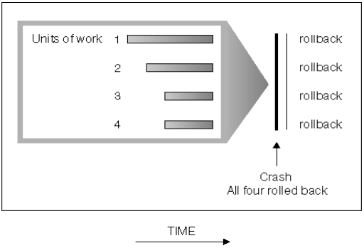
Classification of Failure
Conditions of transaction failure that needs crash recovery:
A power failure on the machine, causing the database manager and the database partitions on it to go down.
A hardware failure such as memory, disk, CPU, or network failure.
A serious operating system error that causes to end the database to abnormally.
Next Topic:
Notes:
Class discussion on real-world applications of databases.
Quiz on basic database terminology.
Hands-on exercise: Create a simple database using DDL commands.

Slide 5
Classification of Failure
To find that where the problem has occurred, we generalize a failure into the following categories:
Transaction failure
System crash
Disk failure
Notes:
Class discussion on real-world applications of databases.
Quiz on basic database terminology.
Hands-on exercise: Create a simple database using DDL commands.

Slide 6
Transaction Failure
The transaction failure occurs when it fails to execute or when it reaches a point from where it can't go any further.
If a few transaction or processes is hurt, then this is called transaction failure.
Reasons for a transaction failure could be -
Logical errors: If a transaction cannot be completed due to some code error or an internal error condition, then the logical error occurs. Such error can be challenging to detect and resolve.
Syntax error: It occurs when the DBMS itself terminates an active transaction because the database system is not able to execute it. For example, The system aborts an active transaction, in case of deadlock or resource unavailability.
Notes:
Class discussion on real-world applications of databases.
Quiz on basic database terminology.
Hands-on exercise: Create a simple database using DDL commands.

Slide 7
System Crash
System failure can occur due to power failure or other hardware or software failure. Example: Operating system error.
Fail-stop assumption: In the system crash, non-volatile storage is assumed not to be corrupted.
Notes:
Class discussion on real-world applications of databases.
Quiz on basic database terminology.
Hands-on exercise: Create a simple database using DDL commands.

Slide 8
Disk Failure
It occurs where hard-disk drives or storage drives used to fail frequently. It was a common problem in the early days of technology evolution.
Disk failure occurs due to the formation of bad sectors, disk head crash, and unreachability to the disk or any other failure, which destroy all or part of disk storage.
Notes:
Class discussion on real-world applications of databases.
Quiz on basic database terminology.
Hands-on exercise: Create a simple database using DDL commands.

Slide 9
Recovery and Atomicity
When a system crashes, it may have several transactions being executed and various files opened for them to modify the data items.
Transactions are made of various operations, which are atomic in nature.
But according to ACID properties of DBMS, atomicity of transactions as a whole must be maintained, that is, either all the operations are executed or none.
Notes:
Class discussion on real-world applications of databases.
Quiz on basic database terminology.
Hands-on exercise: Create a simple database using DDL commands.

Slide 10
Recovery and Atomicity
When a DBMS recovers from a crash, it should maintain the following:
It should check the states of all the transactions, which were being executed.
A transaction may be in the middle of some operation; the DBMS must ensure the atomicity of the transaction in this case.
It should check whether the transaction can be completed now or it needs to be rolled back.
No transactions would be allowed to leave the DBMS in an inconsistent state.
Notes:
Class discussion on real-world applications of databases.
Quiz on basic database terminology.
Hands-on exercise: Create a simple database using DDL commands.

Slide 11
Recovery and Atomicity
There are two types of techniques, which can help a DBMS in recovering as well as maintaining the atomicity of a transaction −
Maintaining the logs of each transaction and writing them onto some stable storage before actually modifying the database.
Maintaining shadow paging, where the changes are done on a volatile memory, and later, the actual database is updated
Notes:
Class discussion on real-world applications of databases.
Quiz on basic database terminology.
Hands-on exercise: Create a simple database using DDL commands.

Slide 12
Log-based Recovery
Log is a sequence of records, which maintains the records of actions performed by a transaction.
Log of each transaction is maintained in some stable storage so that if any failure occurs, then it can be recovered from there.
If any operation is performed on the database, then it will be recorded in the log.
But the process of storing the logs should be done before the actual transaction is applied in the database.
Notes:
Class discussion on real-world applications of databases.
Quiz on basic database terminology.
Hands-on exercise: Create a simple database using DDL commands.

Slide 13
Log-based Recovery
The log file is kept on a stable storage media.
When a transaction enters the system and starts execution, it writes a log about it.
<Tn, Start>
When the transaction Tn modifies an item X, it write logs as follows
<Tn, X, V1, V2>
Here, V1=old data, V2=new value
It reads Tn has changed the value of X, from V1 to V2.
When the transaction finishes, it logs :
<Tn, commit>
When the transaction Tn is aborted:
<Tn, abort>
Notes:
Class discussion on real-world applications of databases.
Quiz on basic database terminology.
Hands-on exercise: Create a simple database using DDL commands.

Slide 14
Log-based Recovery
Let's assume there is a transaction to modify the City of a student. The following logs are written for this transaction.
When the transaction is initiated, then it writes 'start' log.
<T1, Start>
When the transaction T1 modifies the City from ‘Kathmandu’ to ‘Pokhara’, then another log is written to the file.
<T1, City, ‘Kathmandu’, ‘Pokhara’>
When the transaction is finished, then it writes another log to indicate the end of the transaction.
<T1, Commit>
When the transaction Tn is aborted:
<T1, Abort>
Notes:
Class discussion on real-world applications of databases.
Quiz on basic database terminology.
Hands-on exercise: Create a simple database using DDL commands.

Slide 15
Log-based Recovery
Create a log for given transaction T1 and T2.
T1
Read A
A=A-2000
Write A
Read B
B=B+2000
Write B
T2
Read A
A=A+5000
Write A
Read B
B=B+7000
Write B
Log
<T1, Start>
<T1, A, 5000, 3000>
<T1, B, 8000, 10000>
<T1, Commit>
<T2, Start>
<T2, A, 3000, 8000>
<T2, B, 10000, 17000>
<T2, Commit>
Notes:
Class discussion on real-world applications of databases.
Quiz on basic database terminology.
Hands-on exercise: Create a simple database using DDL commands.

Slide 16
Log-based Recovery
There are two approaches to modifying the database:
Deferred database modification:
The deferred modification technique occurs if the transaction does not modify the database until it has been committed.
In this method, all the logs are created and stored in the stable storage, and the database is updated when a transaction is committed.
Immediate database modification:
The Immediate modification technique occurs if database modification occurs while the transaction is still active.
In this technique, the database is modified immediately after every operation. It follows an actual database modification.
Notes:
Class discussion on real-world applications of databases.
Quiz on basic database terminology.
Hands-on exercise: Create a simple database using DDL commands.

Slide 17
Recovery using Log Records
When a system with concurrent transactions crashes and recovers, it behaves in the following manner −
The recovery system reads the logs backwards from the end to the last checkpoint.
It maintains two lists, an undo-list and a redo-list.
If the recovery system sees a log with <Tn, Start> and <Tn, Commit> or just <Tn, Commit>, it puts the transaction in the redo-list.
If the recovery system sees a log with <Tn, Start> but no commit or abort log found, it puts the transaction in undo-list.
All the transactions in the undo-list are then undone and their logs are removed.
All the transactions in the redo-list and their previous logs are removed and then redone before saving their logs.
Notes:
Class discussion on real-world applications of databases.
Quiz on basic database terminology.
Hands-on exercise: Create a simple database using DDL commands.

Slide 18
Checkpoint
The log file may grow too big to be handled at all as the time passes.
Checkpoint is a mechanism where all the previous logs are removed from the system and stored permanently in a storage disk.
Checkpoint declares a point before which the DBMS was in consistent state, and all the transactions were committed.
Notes:
Class discussion on real-world applications of databases.
Quiz on basic database terminology.
Hands-on exercise: Create a simple database using DDL commands.

Slide 19
Shadow Paging
Shadow paging is one of the techniques that is used to recover from failure and
maintain database consistency in the time of failure.
Concept of Shadow Paging:
Step 1 − Page is a segment of memory. Page table is an index of pages. Each table entry points to a page on the disk.
Step 2 − Two-page tables are used during the life of a transaction: the current page table and the shadow page table. Shadow page table is a copy of the current page table.
Step 3 − When a transaction starts, both the tables look identical, the current table is updated for each write operation.
Notes:
Class discussion on real-world applications of databases.
Quiz on basic database terminology.
Hands-on exercise: Create a simple database using DDL commands.

Slide 20
Shadow Paging
Step 4 − The shadow page is never changed during the life of the transaction.
Step 5 − When the current transaction is committed:
the shadow page entry becomes a copy of the current page table entry and
the disk block with the old data is released.
Step 6 − The shadow page table is stored in non-volatile memory.
If the system crash occurs, then the shadow page table is copied to the current page table.
The advantages of shadow paging are as follows −
No need for log records.
No undo/ Redo algorithm.
Recovery is faster
Notes:
Class discussion on real-world applications of databases.
Quiz on basic database terminology.
Hands-on exercise: Create a simple database using DDL commands.

Slide 21
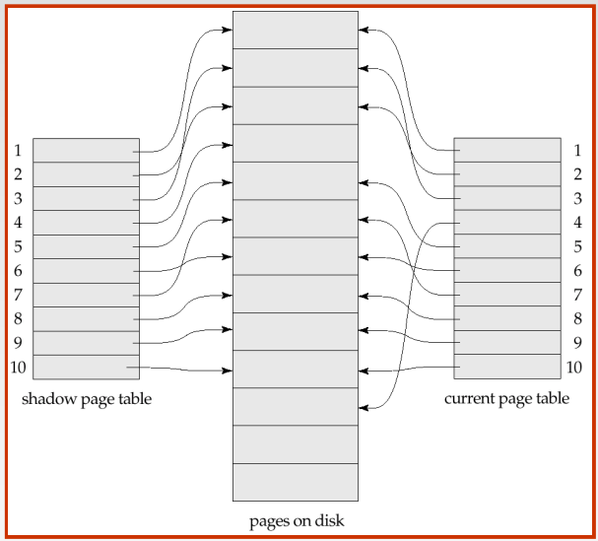
Notes:
Class discussion on real-world applications of databases.
Quiz on basic database terminology.
Hands-on exercise: Create a simple database using DDL commands.

Slide 22
END OF LECTURE 17
SHIVA.KUNWAR@HOTMAIL.COM
+977-9819123654
Google classroom code : drbzdcf

Slide 23
PREVIEW FOR LECTURE 18
ADVANCED DATABASE MODEL

